Slide 1

Big Data Analytics Overview
Saiful Adli Ismail
saifuladli@utm.my

Slide 2
Market Understanding on Predictive Analytics
High
Prescriptive Analytics
What should happened?
Simulation, optimization
Reporting
Analysis
Monitoring
Optimization
Predictive Analytics
What will happened?
Statistics, planning
Complexity
Diagnostic Analytics
Why did it happened?
Ad-hoc query, data mining
Descriptive Analytics
What happened?
Reporting, dashboards
Traditional Reporting vs. Predictive / Advanced Big data Analytics
Low
Business Value

Slide 3
Continued
Descriptive Analytics
Many organizations have spent years generating descriptive analytics — answering what happened questions. This information is valuable, but only provides a high-level, rearview mirror view of the business performance.
Diagnostic Analytics
Most organizations start to apply big data analytics to answer diagnostic questions — how and why something happened. Some might also call this behavioral analytics. Diagnostic analytics with big data helps in two ways: (a) the additional data brought on by the digital age eliminates analytic blind spots, and (b) the how and why deliver insights that pinpoint actions to take.
Predictive Analytics
Answering the how and why questions will reveal specific patterns to identify that detect when outcomes are about to occur. Predictive analytics builds upon the diagnostic analytics to look for these patterns and see what will happen. Machine learning is also applied to continuously learn as new patterns emerge.
Prescriptive Analytics
At the next level, prescriptive analytics will automate decisions and actions — how can I make it happen? Building upon the previous analytics, neural networks and heuristics are applied to the data to recommend the best- possible actions that drive desired outcomes.
Notes:
Think of each of these areas as building blocks that expand your analytics. Big data analytics plays a vital role in expanding the analytics from a backward, reactionary approach to a forward, action-oriented method.

Slide 4
Type Of Analytics
 | Type | What it it? | Example | Skills
1 | Query Based Analytics | Explain/describe a past event in an unstructured format | Data preview List of employees who attended | Data model SQL Business process
2 | Report Base Analytics | Explain/describe a past event in a structured | Month and close package Financial report | Data model SQL Business process Report development
3 | Ad-hoc Reports or Query Analytics | Reaction to an event | How it occurred? Where it occurred? When it occurred? Why it occurred? | Data model Report development SQL Business process
4 | Drill Down and Drill Through Analytics | Root cause discovery | Sales declines Poor customer rating | Data model Report development SQL & Analysis Business process
5 | Notification Analytics | Inform when a root cause occurs again | Generate customer survey report when a new sales invoice | Data model Report development SQL & Analysis Business process

Slide 5
Continued
 | Type | What is it? | Example | Skills
6 | Statistical Based Analytics | Frequency models and regression analysis | How often customer ‘s returning the product Why the are returning | Data model Dashboard development skills SQL & Analysis Statistical skills Business process
7 | Predictive Analytics | Analytics to pro actively understand and control business impacts | Increase in customer buying power Economy impact to business | Data model Predictive model Dashboard development skills SQL & Analysis Statistical skills Business process
8 | Performance Analytics | Analytics to driver and measure corporate strategy/objectives | Revenue Optimization Cost Reductions | Data model Dashboard development skills Performance score card Value drivers SQL & Analysis skills Statistical skills Business process

Slide 6
Continued
 | Type | What is it? | Example | Skills
9 | Forecasting Analytics | What if, trend | Supply vs. demand vs. inventory | Data model Dashboard development skills Performance score card Value drivers SQL & Analysis skills Simulation Business process

Slide 7
TYPE OF ANALYTICS (CONTINUED) - ADVANCED ANALYTICS DEFINED
Advanced analytics is a set of business intelligence tools and techniques that uncovers relationships and patterns within large volumes of data
Advanced analytics includes sophisticated statistical models, machine learning, neural networks, text analytics, and other advanced data mining techniques.
Advanced analytics can be deployed to find prediction, optimization, forecasting, and for complex event processing/analysis.
An ideal advanced analytics solution does not include database query and reporting and OLAP cubes
Examples include
Customer behavior and estimate customer value
Segment a population and Find profiles of targeted people
Determine important relationships and “market baskets” and Find fraudulent or “rare events”

Slide 8
TYPE OF ANALYTICS (CONTINUED) - PREDICTIVE ANALYTICS
…the process of discovering
meaningful new correlations,
patterns and trends by sifting
through large amounts of data
stored in repositories, using
pattern recognition
technologies as well as
statistical and mathematical
techniques.”
Predictive analysis encompasses a range of analytic techniques
Gartner Group
…the exploration and
analysis, by automatic or
semi-automatic means, of
large quantities of data in
order to discover meaningful
patterns and rules.”
“Data Mining Techniques”
Gordon Linoff
Michael Berry

Slide 9
TYPE OF ANALYTICS (CONTINUED) PREDICTIVE ANALYTICS DEFINED (CONTINUED)
Through predictive analytics
Pricing Forecasting at SKU Level
A finance organization needs to work with detailed projection for unit sales and revenues at the stock-keeping unit (SKU) level. Predictive analytics solutions allows to interactively explore the financial and volume implications of price changes in specific geographic markets or channels.
Identify hidden revenue opportunities within your customer base
Retain your high-value customers/employees/vendors/partners with the right retention offers
Increase cross-sell and up-sell effectiveness through cross-channel coordination?
Build long-term customer/employee/vendor/partner relationships with intelligent interactions
Delight customers with the best next-step recommendations

Slide 10
ANALYTICS - ADVANCED AND PREDICTIVE BUSINESS CHALLENGES
Companies have been making business decisions based on transactional data stored in relational databases. Beyond that critical data, however, is a potential treasure trove of non-traditional, less structured data: weblogs, social media, email, sensors, and photographs that can be mined for useful information.
Information and Analytics driven enterprise - More and more companies are looking for “360 degrees” view on their strategy execution, operations, management and growth.
Cross functional data (Oracle , PS, JDE, etc.) - Organizations wanted to include nontraditional yet potentially very valuable data with their traditional enterprise data in their business intelligence analysis.
Real-time data and timeliness - Improve the quality of decision-making and deeper and higher level insights
Lack of innovation, leadership and competencies
Inadequate standards, design, methodology and approach
Integrating new technologies into existing BI architecture - Tools to capture and organize a wide variety of data types from different sources, and to be able to easily analyze it within the context of all your enterprise data

Slide 11
PREDICTIVE ANALYTICS CHALLENGES
How do historical sales, costs, key
performance metrics, and so on, translate to
future performance? How do predicted
results compare with goals?
Challenges
Forecasting
Key Influencers
Trends
Anomalies
Relationship
What anomalies might
exist and conversely
what groupings or
clusters might exist for
specific analysis?
What are the main
influencers of customer
satisfaction, customer
churn, employee turnover,
and so on, that impact
success?
What are the correlations in
the data? What are the crosssell
and up-sell
opportunities?
What are the trends: historical /
emerging, sudden step changes,
unusual numeric values that
impact the business?

Slide 12
CHANGING BUSINESS AND NEW OPPORTUNITIES PREDICTIVE & ADVANCED ANALYTICS
Data mining and predictive have been around for decades. But new market forces are changing the landscape and offering new opportunities…
Increased business interest
Increase data value (e.g., Big data)
Increasing technology performance
Now that BI users know what happened, they are asking why and what’s likely to happen next
Explosive demand from sales, marketing, and call center analysis, fraud and government intelligence/security agencies
Exploding data volume
Expanding data varieties
Parallel processing, faster CPUs, and in-memory technologies reduce time and cost of data processing

Slide 13
CHANGING BUSINESS AND NEW OPPORTUNITIES PREDICTIVE & ADVANCED ANALYTICS
Companies can no longer focus solely on delivering the best product or service
To succeed, they must
Uncover hidden customer / employee / vendor / partner trends and insights
Anticipate behaviour and take proactive action
Empower your team with intelligent next steps to exceed customer expectations
Create new offers to increase market share and profitability
Develop and execute a customer-centric strategy
Target the right offers to the right customers through the best channels at the most opportune time
Create new offers to increase market share and profitability
Develop and execute a customer-centric strategy
Target the right offers to the right customers through the best channels at the most opportune time

Slide 14
BIG DATA ANALYTICS USE CASES – SAMPLE PREDICTIVE & ADVANCED ANALYTICS
Healthcare
Manufacturing
Large healthcare groups use big data analytics for population health analysis to predict epidemics, cure disease, improve quality of life and avoid preventable deaths.
Traditional healthcare providers are using applying data from medical devices, doctor’s notes, lab results and more to drive big data analytics that improve patient care and increase efficiency.
Insurers and healthcare providers use big data analytics to streamline payment processes and better monitor for claims fraud.
Manufacturers use big data analytics to identify patterns and relationships among discrete process steps and inputs, and then optimize the factors that improve efficiency.
By using big data analytics on a growing flow of real- time sensor and machine data, manufacturers can improve yields, increase quality and ship products on schedule.
Manufacturers optimize supply chains and logistics with big data analytics by analyzing supplier and logistics tracking data with cost and historical logistics data.

Slide 15
BIG DATA ANALYTICS USE CASES – SAMPLE PREDICTIVE & ADVANCED ANALYTICS (continued)
Energy
Retail
Oil and gas companies collect and use big data analytics on sub-surface and geographic characteristics to improve geology interpretation, new well delivery and well optimization.
By using big data analytics on well and reservoir data, energy firms can predict their performance and production, and identify ways to optimize future production and hydrocarbon delivery.
Energy companies are using big data analytics on assets and equipment for predictive maintenance and optimal use of assets to reduce capital expenditures.
Most retailers have a handle on the “What’s selling?” question. They’re applying big data analytics to understand why consumers are buying and then tailoring their responses to influence sales.
The Omni-channel customer journey is elusive to many retailers, driving them to use big data analytics to better understand customer behavior and influence to drive actions that influence more profitable outcomes.
Faster product life cycles and ever-complex operations cause retailers to use big data analytics to understand supply chains and product distribution to reduce costs.
Notes:
Other industries that used big data analytics are:
1 Manufacturing
2 Technology
3 Telecommunications
4 Financial Services

Slide 16
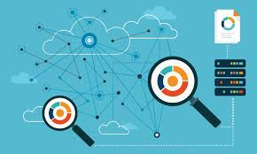
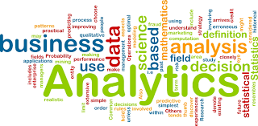
How to implement Big Data Analytics
Business objectives and answers to questions are the primary drivers of big data analytics. Understanding these needs is an essential part of any process to implement big data analytics in your company. A process to deliver success at your organization involves four components.

Slide 17




How to implement Big Data Analytics (continued)
Use Case Discovery
Answer Discovery
Operationalization
Proof of Value
The business, analyst and IT teams should work together to identify the key big data use cases. Hold a use case discovery workshop to uncover the attributes of key use cases (data sources, potential business value and ROI, barriers to implementation) and help prioritize implementing the use case
Using some of the data, use data discovery for the top priority use case to find new patterns, outcomes and opportunities hidden within the data. Use this to demonstrate the fit and value of your analytics and build a projected ROI model for business teams to evaluate.
Bring the data from all sources into your big data analytics platform, prepare it and use data discovery and advanced analytics to let the data reveal answers. This is often an iterative process by which the analyst fluidly moves between the data integration, preparation and analysis steps to discover answers.
After finding the analytic patterns, deploy the analytics to the business teams. This involves defining and implementing the attributes of the repeated process that will produce results, including job execution, data retention policies, security models and integration with downstream applications or tools used by the business users.

Slide 18
How to implement Big Data Analytics (continued)
Use Case Discovery
As the business uses analytics, you should continuously measure progress in well- defined time frames. New data will be generated, creating the need to re-visit the analytics to continuously improve them.
In parallel, go back and discover the next groups of high-priority use cases with the business teams. In many cases, the new use cases should leverage existing data and analytics from existing use cases.
Proof of Value
(POV)
Deliver more Use Cases
Discovery Answer
Continuously Improve
Operation-alize to the business
(Datameer, 2015)

Slide 19
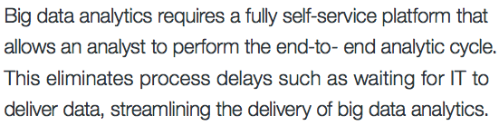
How to Discover Answer with Big Data Analytics

Slide 20


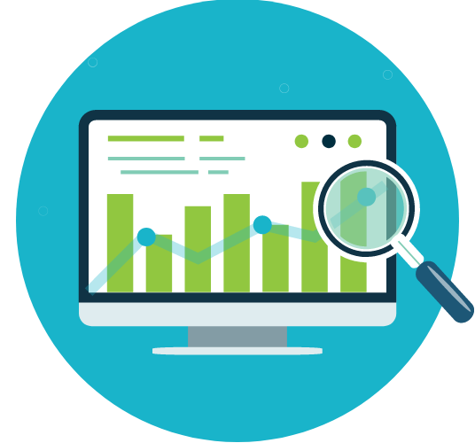

continued
Integrate
Analyze
Visualize
Prepare
The digital age is generating vast volumes of data in many different formats. Big data analytics simplifies the integration steps by connecting to and understanding the data the analysts require.
Analysts can spend up to 80 percent of their time preparing their data for analysis. With vast volumes and a variety of big data, an analytic platform needs to help the analyst cleanse, transform and organize their data faster and easier.
Answering “how” and “why” questions on big data requires a vast number of analytic functions that range from simple aggregations to advanced algorithms. A strong big data analytics platform must make it easy to apply these functions to find patterns deep within the data.
Big data analytics requires a new range of visualization capabilities that can show signals within the noise. Visualization must be easily applied to the analytic result sets to show both analysts and business teams new trends and patterns.

Slide 21
BIG DATA ANALYTICS METHODOLOGY IMPLEMENTATION ACCELERATORS
Strategic objective
Measures
Key Influencers
Strategy
Grow market share and revenue.
Profitable growth and efficient use of Capital.
Outcome Metric
Market Share.
Revenue.
Operating
Margin.
Cash flow.
Capital Efficiency.
Key Influencers
Prospective Customer (call, click, visit count).
Conversion rate for prospects to customer
Distribution coverage.
Quality ranking.
Customer Sentiment

Slide 22
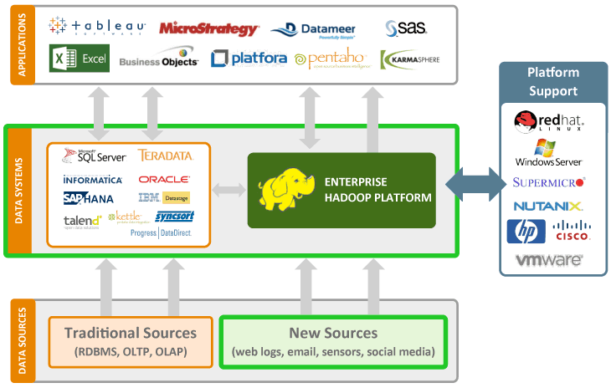
ADVANCED ANALYTICS ENABLING TECHNOLOGIES

Slide 23
BIG DATA ANALYTICS - ENABLING TECHNOLOGIES HADOOP
HADOOP (High-availability distributed object-oriented platform) is a way of storing enormous data sets across distributed clusters of servers and then running "distributed" analysis applications in each cluster.
HADOOP stores data and we can pull data out of it, but there are no queries involved - SQL or otherwise. Hadoop is more of a data warehousing system - so it needs a system like MapReduce to actually process the data.
Who Uses HADOOP
Amazon/A9
Facebook
Google
IBM
New York Times
Yahoo! …

Slide 24
BIG DATA ANALYTICS - ENABLING TECHNOLOGIES - HADOOP KEY CAPABILITIES
Business Usage
Search
Yahoo, Amazon, etc
Log processing
Facebook, Yahoo, ContextWeb, Joost, Last.fm
Recommendation Systems
Facebook
Data Warehouse
Facebook, AOL
Open Data Format
Flexible Scheme (Data may not have strict schema)
Massively Scalable File Systems (Multi Petabyte)
Archival store
Query able Database

Slide 25
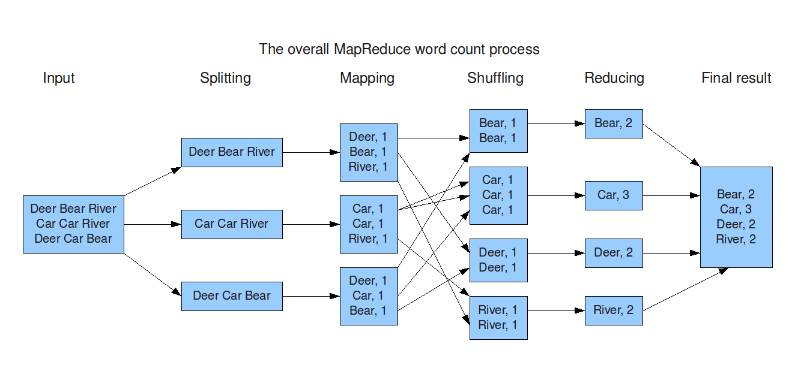
BIG DATA ANALYTICS - ENABLING TECHNOLOGIES - HADOOP MAPREDUCE
HADOOP MapReduce (HADOOP Map/Reduce) is a software framework for distributed processing of large data sets on compute clusters of commodity hardware. MapReduce runs as a series of jobs, with each job essentially a separate Java application that goes out into the data and starts pulling out information as needed. Using MapReduce instead of a query gives data seekers a lot of power and flexibility, but also adds a lot of complexity.
MapReduce takes care of scheduling tasks, monitoring them and re-executing any failed tasks

Slide 26


Continued
HADOOP includes Hive, another Apache application that helps convert query language into MapReduce jobs. But MapReduce's complexity and its limitation to one-job-at-a-time batch processing tends to result in HADOOP getting used more often as a data warehousing than as a data analysis tool
Hive is a data warehouse system for HADOOP that facilitates easy data summarization, ad-hoc queries, and the analysis of large datasets stored in HADOOP compatible file systems. Hive provides a mechanism to project structure onto this data and query the data using a SQL-like language called HiveQL. At the same time this language also allows traditional map/reduce programmers to plug in their custom mappers and reducers when it is inconvenient or inefficient to express this logic in HiveQL.

Slide 27
BIG DATA ANALYTICS - ENABLING TECHNOLOGIES - HADOOP “R”, PYTHON, MACHINE LEARNING
Big Data Analytics – Enabling Technologies
“R” Statistical Computing
The R statistical programming language is a free open source package based on the S language developed by Bell Labs
R is A language and environment for data manipulation, calculation and graphical display
Python
Python is Scientific Computing it has had the fundamental building blocks necessary for doing Data Analysis.
Python for Big Data analysis is all about manipulating , processing, cleaning, and crunching Big Data in python
Machine Learning
Machine learning is similar to data mining. Search through data to look for patterns.
Machine learning programs detect patterns in data and adjust program actions accordingly.
HADOOP Data Platform

Slide 28


Slide 29

Assignment Discussion

